Slide 1
Application Modeling
With Morphir

Slide 2




Introduction
Open-sourced by Morgan Stanley:
Morphir
Goals:
Productivity
Efficiency
Risk
Stakes:
Costs
Reputation
Competitivity
Desired Outcome:
New ways to develop
Community participation

Slide 3
Why Morphir?
Value:
Development automation
Effortless compliance
Bug free guarantees
Who:
App developers
Infrastructure engineers
Business users & analysts
Learn More:
Morphir open-source

Slide 4
Common Impediments
Developers
Most development effort on non-business code.
Keeping up-to-date is a costly burden.
Infrastructure engineers
Lack of consistency prevents holistic optimization & automation
Business users
Disconnect between business and technology
Lack of transparency

Slide 5
Example: Developer Effort
The most value
The most effort
Turn business concepts into computer concepts
Make it run
Code to frameworks & libraries
Conform to regulations (i.e., Policy 2.0)
Ensure the code does what it’s supposed to
Keep documents up-to-date
Hygiene & keeping tech up-to-date
Follow blueprints and best practices
Monitoring
Security & vulnerability remediation
Supportability
Testing
Audit
Plug into firm infrastructure (i.e., API Gateway)
Evolution & future readiness (i.e., cloud)
Telemetry, metrics, and observability (i.e., Backtrace)

Slide 6
What if…
Let developers focus on this:
Automate this:
Turn business concepts into computer concepts
Make it run
Code to frameworks & libraries
Conform to regulations (i.e., Policy 2.0)
Ensure the code does what it’s supposed to
Keep documents up-to-date
Hygiene & keeping tech up-to-date
Follow blueprints and best practices
Monitoring
Security & vulnerability remediation
Supportability
Testing
Audit
Plug into firm infrastructure (i.e., API Gateway)
Evolution & future readiness (i.e., cloud)
Telemetry, metrics, and observability (i.e., Backtrace)

Slide 7
Demo
Morphir + Dapr

Slide 8
Optimize the Development Pipeline
Manual
Semi
Automatic
Automatic
Capture business specs
Architect solution
Code
Build
Test
Deploy
Development now
Capture business specs
Architect solution
Code
Build
Test
Deploy
+ developer automation
Development with Morphir + Dapr

Slide 9
The Tools
Dapr
Morphir
Framework:
Infrastructure abstraction
Cloud and on-prem
Out-of-the box features
Open-sourced by Microsoft
Application modeling
Development automation
Knowledge tools
Correctness
Open-sourced by Morgan Stanley

Slide 10
Modeling services
Patterns enable automation
Modeling defines those patterns
Demo pattern = service
Take requests to perform some action
Produce a result
Manage some state
Simple Books & Records service for managing deals

Slide 11
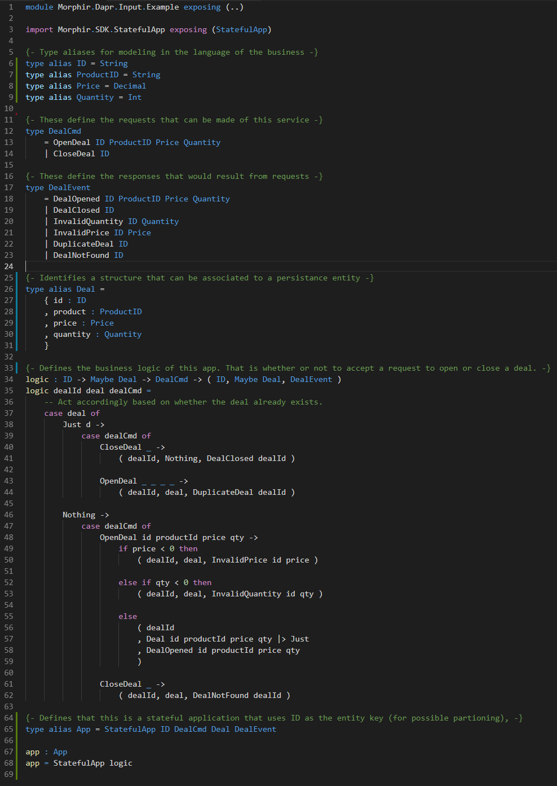


Books & Records Service: Request
Specifications:
As a client, I want to instruct to record a new deal for a quantity of a product at a specified price…
As a client, I want to instruct to close an existing deal…

Slide 12
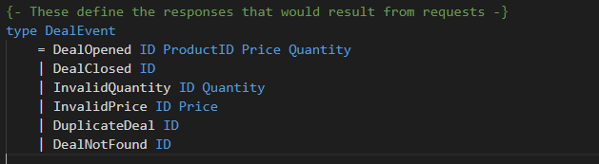
Books & Records Service: Result
Specifications:
As a client, I want to know how my instructions were processed…
As an interested party, I want to be notified of any deal activity…
As a regulator, I want to ensure there’s a temporal system of record for all deal activity…

Slide 13
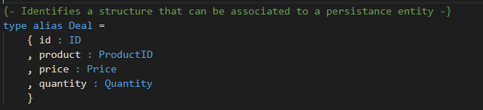
Books & Records Service: State
Specifications:
As a client, I want the state of all of my deals to be accessible at any time…
As a system owner, I want to ensure that deal state is resilient to process restarts…

Slide 14
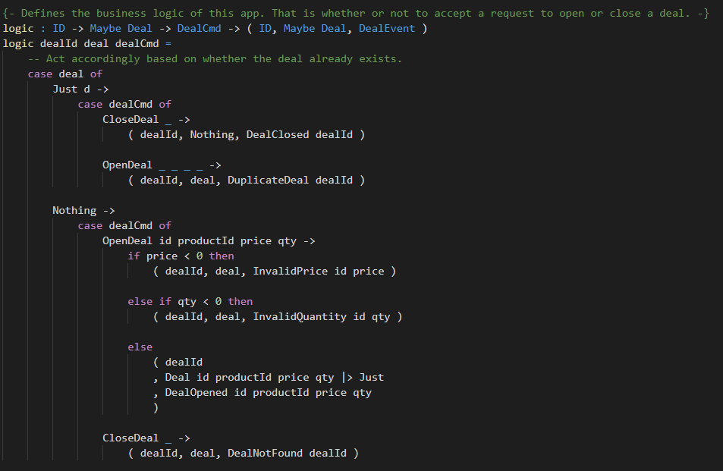
Books & Records Service: Processing logic
Specifications:
As a business owner, I want an open deal request to be accepted only if that deal doesn’t already exist, the price is free or more, and the quantity is 1 or more.
As a business owner, I want a close deal request to be accepted only if the deal is currently open.

Slide 15
What we automated
Code
JSON serialization
Code
JSON serialization
Kafka Publish
Code
Persistence
Code
REST binding

Slide 16
What else could we automate?
Code
JSON serialization
Observability & telemetry
Policy 2.0 Data dictionary & lineage
Documentation & audit
Service Discovery
OpenAPI / API Gateway
GraphQL
Schema registry
Cloud & security Blueprints
Contract-Driven Development full verification
Tests
Hygiene & Vulnerability remediation
Firm-wide Performance optimizations
Cloud readiness
Future platforms…
Code
JSON serialization
Kafka Publish
Code
Persistence
Code
REST binding

Slide 17
The Code(s)
Morphir
Application Model
Query
Generated
Dapr
Spring Boot

Slide 18
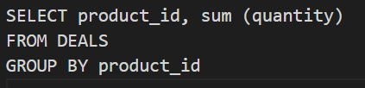
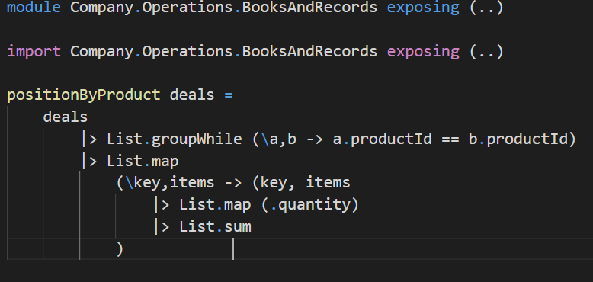
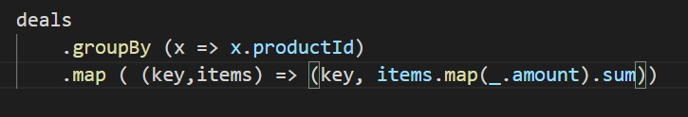
Other patterns…
Query & Aggregation
SQL
Morphir Model
Spark, Kafka Streams, Jet, Flink…

Slide 19
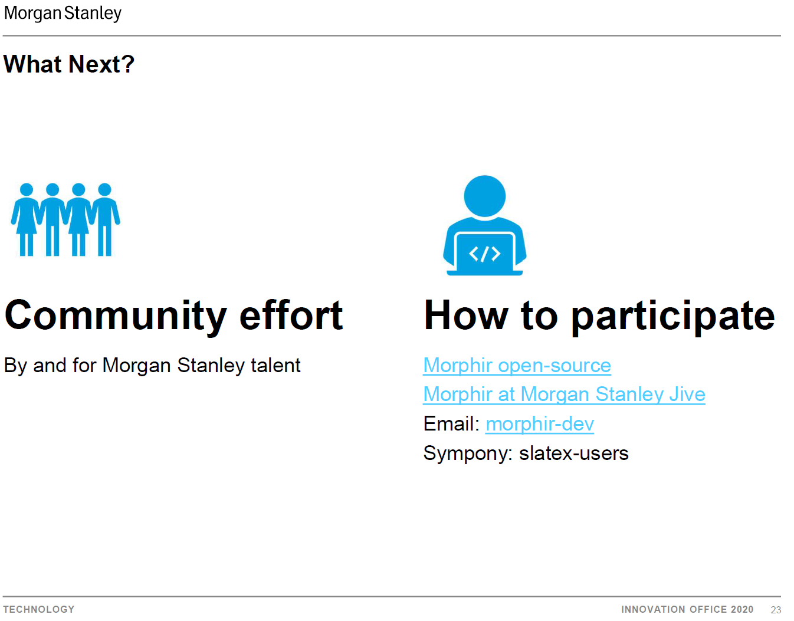
What’s Next?
Community
By developers for developers
Open-source
Morphir

